Slide 1
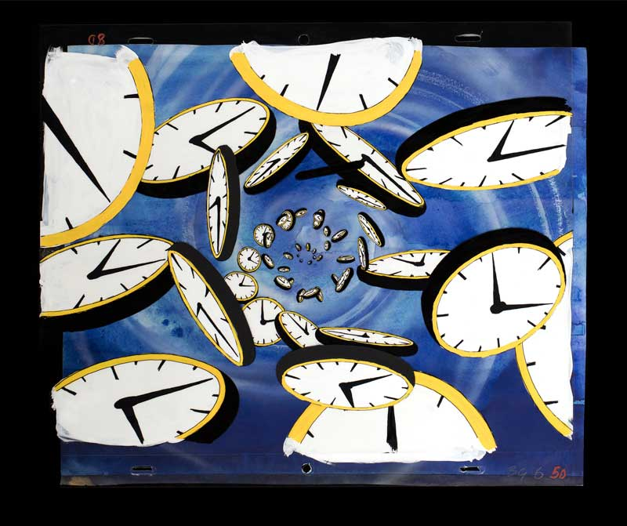

Procrastination
Procrastination
Common Causes and Fixes

Slide 2
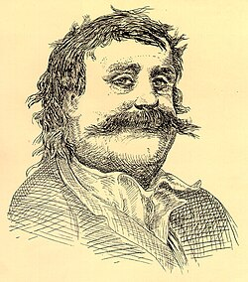





What is Procrastination?

Slide 3


Introduction
Procrastination is a serious problem, especially among the young, unexperienced people. They tend to put things away for later, only for them to realize that the deadline is looming and they are completely unprepared.
Thypical example of Procrastination:
Cyberbullying
random people
Studying

Slide 4
Reasons for procrastination

Slide 5

Fear of failure, low motivation, and perfectionism often make it harder to start working on something.

Slide 6
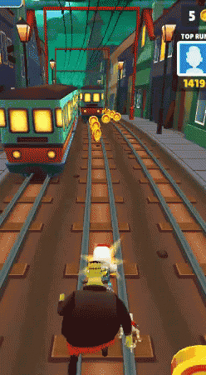
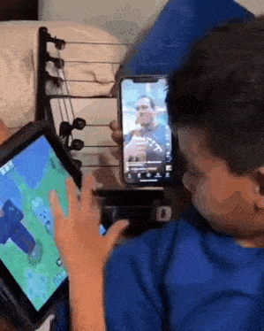

Environmental Influences
Distractions surrounding you often cause procrastination.

Slide 7

Unclear goals, overwhelming workload, and lack of interest in tasks often lead to procrastination.

Slide 8

Solutions to Procrastination

Slide 9


Time Management Techniques
Using tools like the Pomodoro Technique and prioritizing tasks helps increase focus and reduce delays. It’s also good to isolate yourself from every form of distractions.

Slide 10
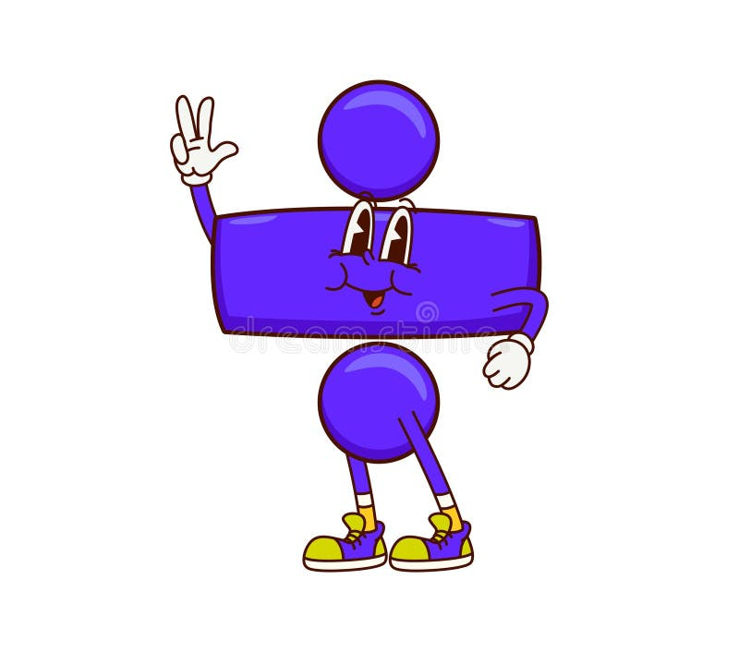

Behavioral Strategies
Dividing your goals into smaller parts and setting a reward system can boost your confidence and effectiveness significantly.

Slide 11

Environmental Adjustments
Creating a distraction-free workspace and setting clear deadlines improve productivity and task completion.

Slide 12
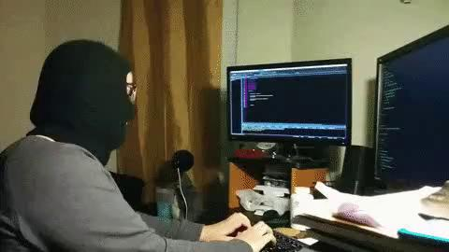

Lifestyle

Slide 13
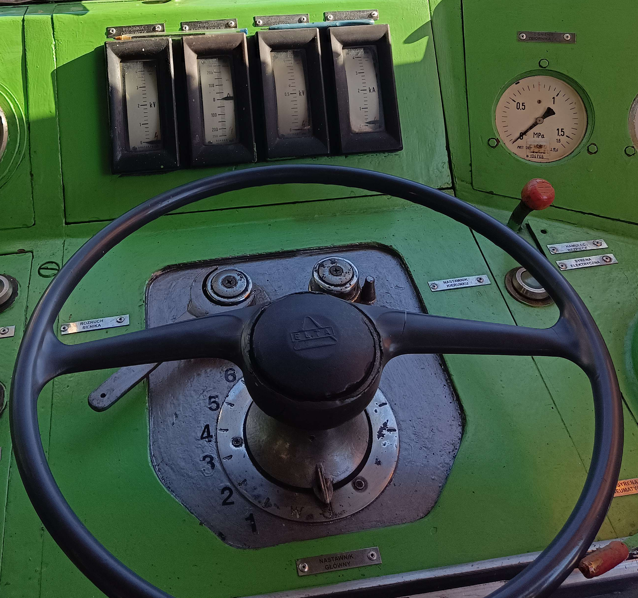

Conclusions
Procrastination is hard to control, but with nothing but a little of dedication, you shall overcome it.
Everything is in your hands.

Slide 14





Questions
What is the main factor contributing to your procrastination? How do you deal with it?
Which solution to procrastination is most appealing to you and why?

